Slide 1
Week 4
Sound and Music’ish

Slide 2


This Week is brought to you with the Letters F F and T

Slide 3
But first lets play music
The Arduino is not brilliant at playing music.
Don’t Expect C.D Quality sound.
But it can make fun and interesting Beeps, Bloops and Whistles.
Lets connect our circuit

Slide 4
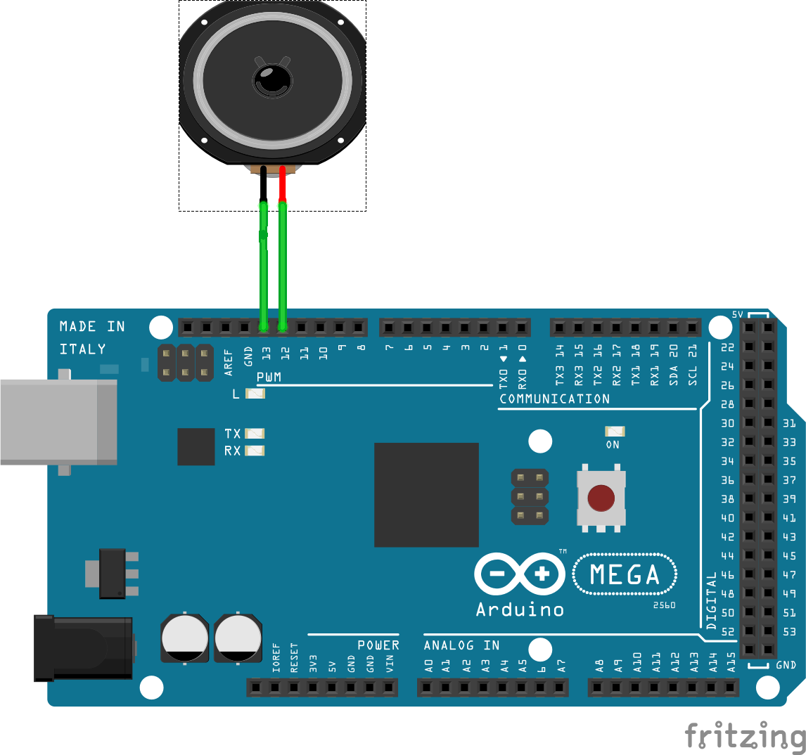
Playing with Music and Sounds
Hhhh
Use Pins 11 and 12 on an Arduino Mega2560
Use Pins 12 and 13 on a Arduino Uno or Nano
Connect them either way around.

Slide 5
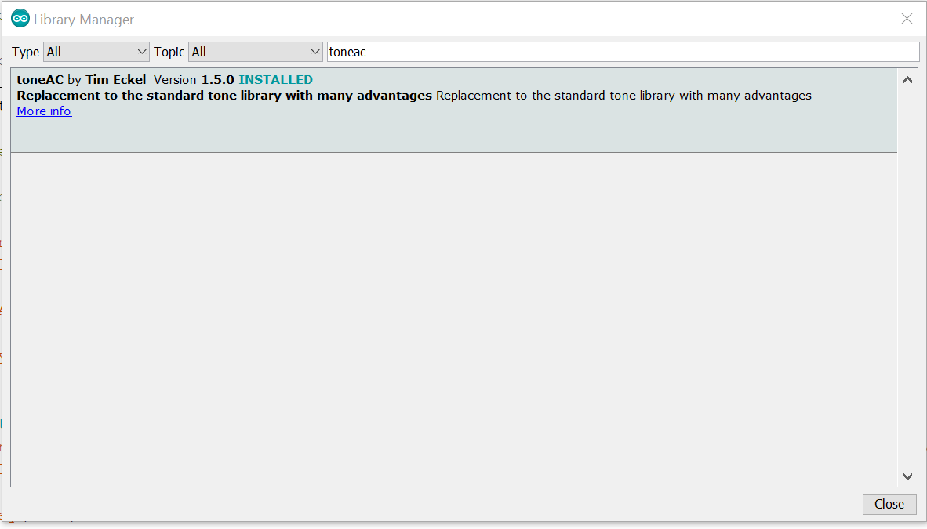
Install the toneac Library
Tools > Manage Libraries

Slide 6
Open toneac_Demo from the Folder on your desktop
Two things we haven’t seen before
Before Setup
int melody[] = { 262, 196, 196, 220, 196, 0, 247, 262 };
Melody is an array.
It has been declared as an int. So it can contain multiple ints.
https://www.arduino.cc/reference/en/language/variables/data-types/array/

Slide 7
Next Thing
In Setup()
Serial.begin(9600);
This lets us use the serial Port to send data from the Arduino back to our Laptop
In the For Loop
Serial.println(melody[thisNote]);
This is great for debugging our program and monitoring it when running

Slide 8
Serial is accessed from
Tools > Serial Monitor.
Make sure the speed it is set to is the same as declared in the line.- (Bottom Right hand Corner)
Serial.begin(9600);

Slide 9
Have a play creating tunes. For each note in int melody[] = { 262, 196, 196, 220, 196, 0, 247, 262 }; There needs to be a duration in int noteDurations[] = { 4, 8, 8, 4, 4, 4, 4, 4 };

Slide 10
Uncomment the line //int melody[] = { c4, g3, a3, a3,g3, 0, b3,c4 }; And Comment out int melody[] = { 262, 196, 196, 220, 196, 0, 247, 262 }; To use the defined notes above rather than the Numbers.

Slide 11
And now for something completely different’ish

Slide 12
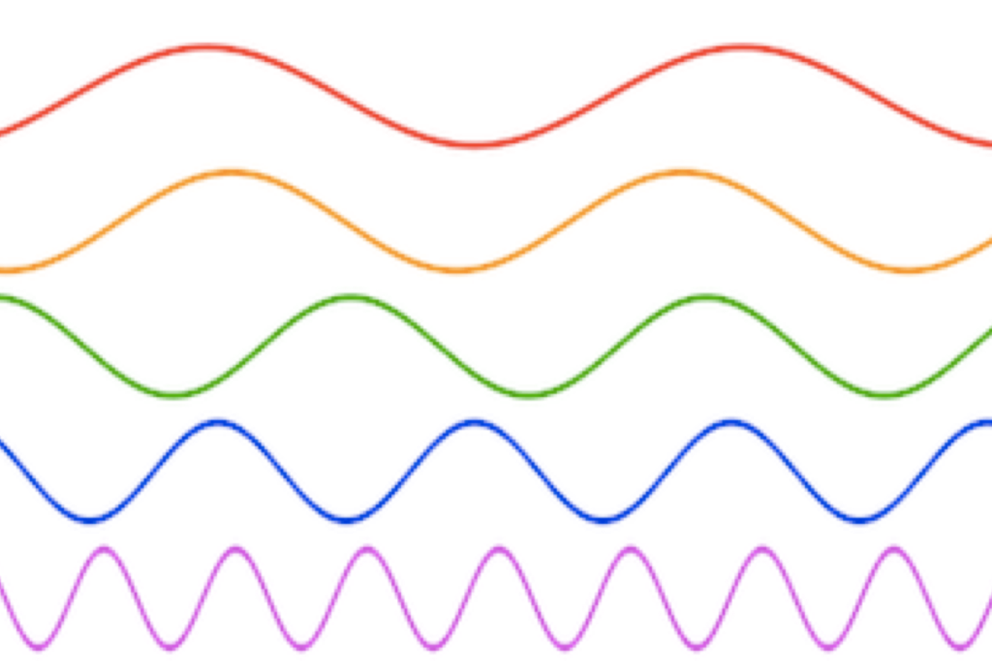
Its Sine Waves all the way down
My Voice, sound and music can be separated into Sine Waves.

Slide 13
We can separate music and speech into separate Sine Waves on an Arduino using FFT Libraries. Bit about FFT. Its short for Fast Fourier Transform To learn more about Fourier Transform watch https://www.youtube.com/watch?v=spUNpyF58BY Especially the first 10 minutes

Slide 14
We are going to concentrate on what we can do with the output of the FFT and not worry about how it actually works. There are lots of books and University courses that go into that. But it’s really useful to know when playing with Sound

Slide 15
